Slide 1
Current challenges in modelling the effect of public R&D Werner Roeger European Commission DG ECFIN October 2018
The views expressed in this presentation are those of the author and not necessarily those of the European Commission

Slide 2
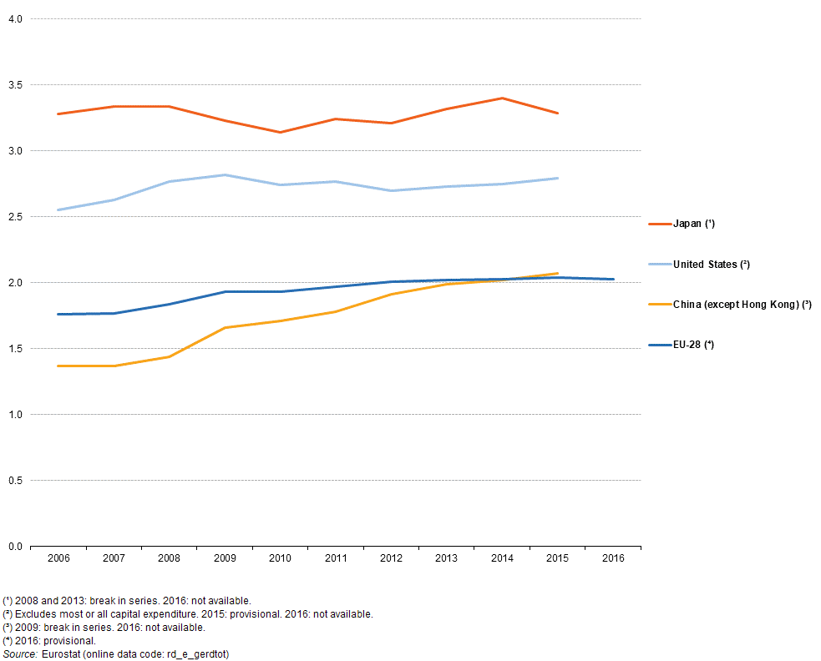
Gross domestic expenditure on R & D, 2006-2016(%, relative to GDP)
R&D share has gradually increased in EU, but stopped growing in recent years.

Slide 3
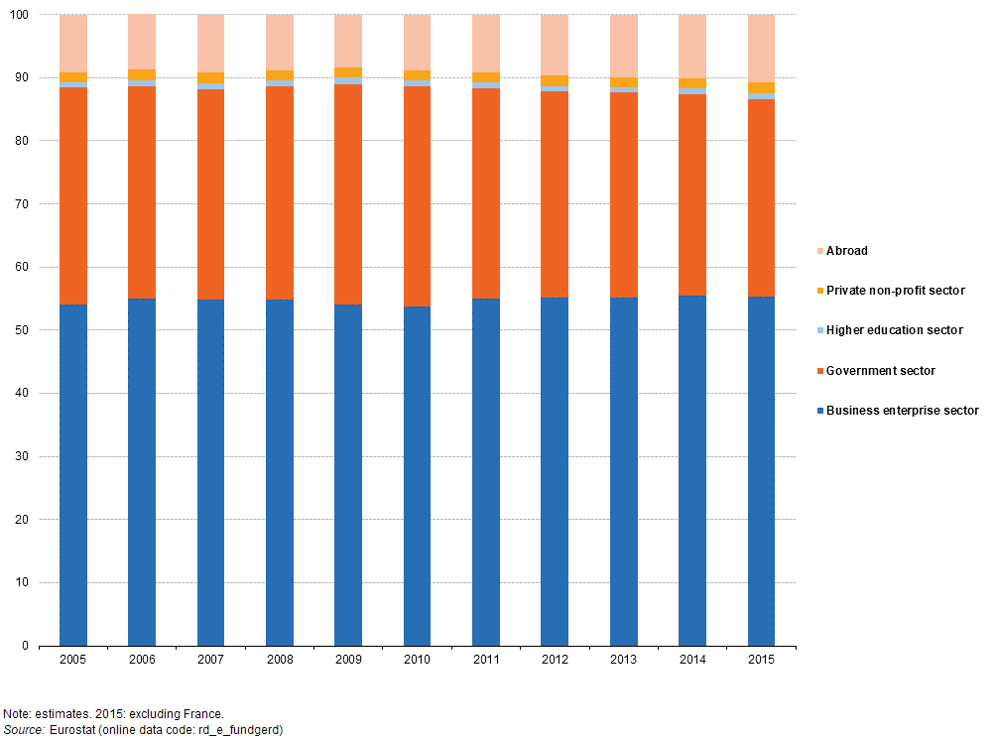
Gross domestic expenditure on R & D by source of funds, EU-28, 2005-2015(% share of total)
Government funding has been relatively stable

Slide 4
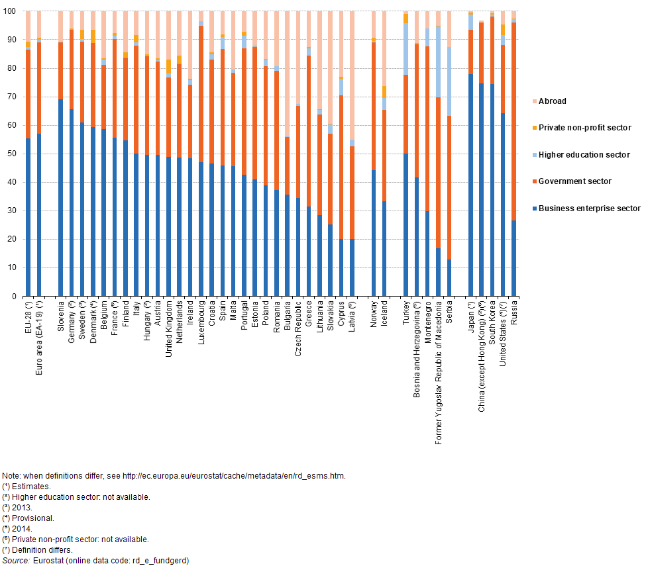
Gross domestic expenditure on R & D by source of funds, 2015(% share of total)
There is some variation across countries (below 20% in SI and above 40% in EE)

Slide 5
Public R&D has various dimensions
R&D undertaken by government researchers (in research institutes and universities: basic research+public private cooperation)
Government funded R&D, via subsidies and tax credits.
Current models can basically deal with the latter.
This talk:
Provide some information about a so called ex ante impact assessment of the new Horizon Europe Program
What are the estimated GDP effects generated by three different models?

Slide 6
Structure of presentation Model description The Horizon Europe Program Macroeconomic impact of the Program (using QUEST) How does the GDP effect depend on how public R&D support is financed? What are the international spillover effects of such a shock? How sensitive is the effect across models?

Slide 7
QUEST III R&D: Semi endogenous growth model (following Romer and Jones)
DSGE model family:
Microfounded, forward-looking dynamic stochastic GE models (IMF: GIMF, ECB: NAWM, FED:SIGMA)
Global model (28 MS plus RoW)
Basic characteristics of the QUEST R&D model:
Households
Final goods producing firms (imperfectly competitive)
Intermediate goods producing firms (free entry)
R&D sector (perfectly competitive)
Monetary and fiscal authorities
Disaggregation of labour force: low-, medium, high skilled
Technological change: increasing product variety

Slide 8
Wage subsidies for R&D workers
R&D tax credits for intermediate firms
Multi country: All EU member states and RoW

Slide 9
Public R&D:
In QUEST only private R&D is modelled.
Models are essentially used for analysing the effects of public funding for private R&D
Stock of knowledge A:
$$∆A_{t}=νA_{t−1}^{∗ω}{A_{t−1}^{φ}L}_{At}^{λ}−δA_{t−1}$$
Possible extension:
L: CES aggregate of private and public R&D workers
Interactions between basic (public) and applied (private) research

Slide 10
The Horizon Europe Program
Ex ante evaluation of Horizon Europe: (2021-2027) Framework Program.
Proposed Budget ca. 100 Bio. Euro over the period (2021-27) => ca. 0.7% of 2018 EU27 GDP.
Questions:
How large is the GDP effect?
When are the effects likely to arrive?
What is the effect relative to alternative use of the funds?

Slide 11
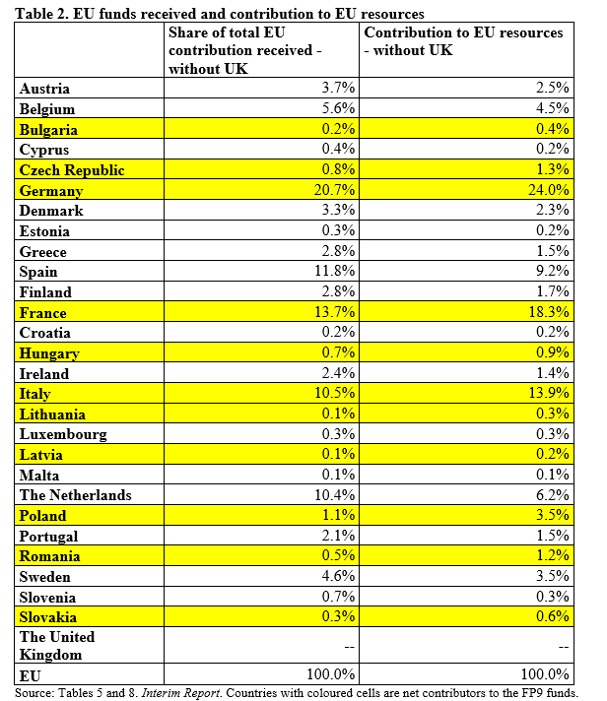
Net contributors to program

Slide 12
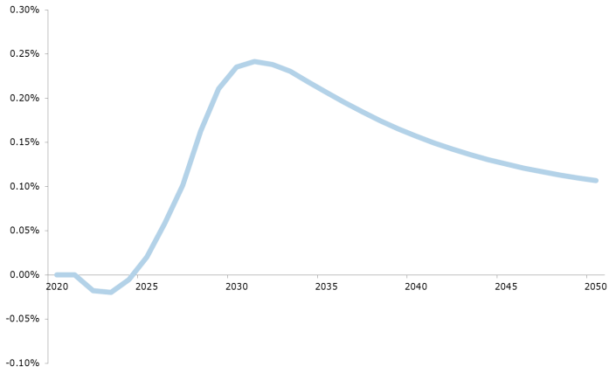
Horizon Europe (2021-27): QUEST Results (VAT financing)
Short run: Negative effect: (1) increase of VAT, (2) reallocation of high skilled from production into research
Medium run: More R&D output in second half of the program
Long run: Dynamic effects: domestic knowledge stock increases MPL(A), International spillover dynamics.

Slide 13
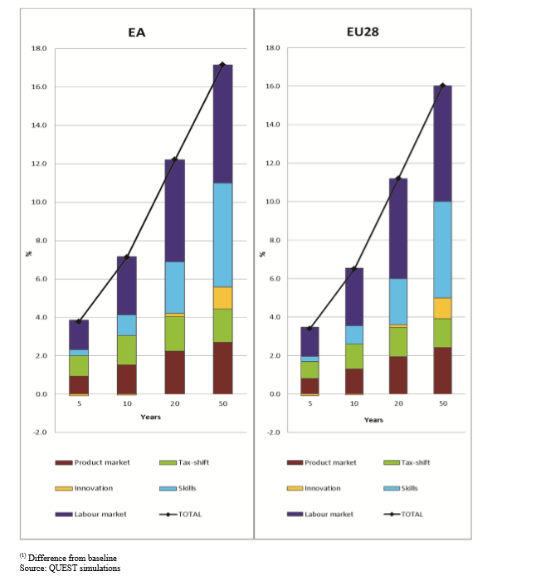
Growth effects from moving to best practice
What are the growth effects for the EU if all countries move (50%) towards the highest levels of R&D funding?
Growth effects show up after 10 years.

Slide 14
How do these estimates depend on financing assumptions?
Often the assumption is made that R&D funding is financed by reducing unproductive government spending or by (least) distortionary taxes.
In QUEST we follow the latter strategy, namely VAT financing
VAT is less distortionary than labour tax financing because VAT is partly financed from
Consumption of distributed profits and from transfers.
How does the GDP effect change if it is financed by more distortionary measures such as a reduction of public investment?

Slide 15
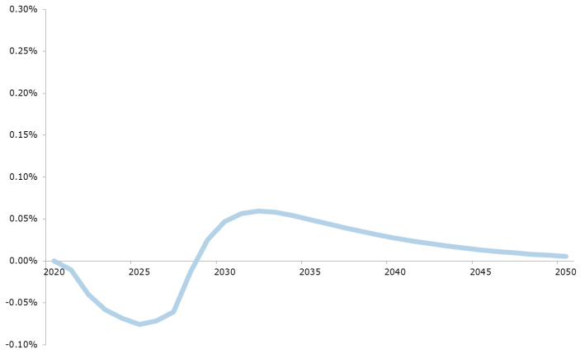
Sensitivity of results to government financing of R&D
Increasing VAT Reducing public investment
Large expenditure multiplier (short run)
Long run output elasticity of physisical capital

Slide 16
A possible large externality of R&D investment is often underestimated in purely national assessments of public R&D: International technology spillovers in QUEST
This is especially important if one assesses EU wide funding programs
In QUEST:
Additional knowledge is produced with a knowledge production function which uses R&D labour as well as the domestic (A) and foreign knowledge (A*) as input.
Domestic knowledge stock:
$$∆A_{t}=νA_{t−1}^{∗ω}{A_{t−1}^{φ}L}_{At}^{λ}−δA_{t−1}$$
Foreign knowledge stock:
$$∆A_{t}^{∗}=ν^{∗}A_{t−1}^{ω}{A_{t−1}^{∗φ}L}_{A^{∗}t}^{∗λ}−δA_{t−1}^{∗}$$
And A* is a trade weighted knowledge stock of all trading partners

Slide 17
2nd column
How much does EU GDP increase (%deviation from baseline) if one Nio Euro is given to country j?
3rd column
Marginal productivity of labour in the research sector.

Slide 18
International technology spillovers are possibly too strong
Domestic knowledge stock
$$∆A_{t}=νA_{t−1}^{∗ω}{A_{t−1}^{φ}L}_{At}^{λ}−δA_{t−1}$$
Foreign knowledge stock
$$∆A_{t}^{∗}=ν^{∗}A_{t−1}^{ω}{A_{t−1}^{∗φ}L}_{A^{∗}t}^{∗λ}−δA_{t−1}^{∗}$$
Spillovers are possibly more unidirectional: from frontier firms to laggards.
Modified Foreign component (in domestic knowledge stock)
$$∆A_{t}^{∗D}=ν^{∗}{A_{t−1}^{∗φ}L}_{A^{∗}t}^{∗λ}−δA_{t−1}^{∗}$$
Domestic economy only benefits from foreign value added.

Slide 19
Dynamic R&D effects with standard and limited spillovers
Standard spillover setting => GDP effects of a temporary R&D shock very persistent.
Limited spillover setting => GDP effect die out after some time.
Initial effect is not very different because level differentials in 2050 have no significant impact on current investment and consumption decisions)

Slide 20
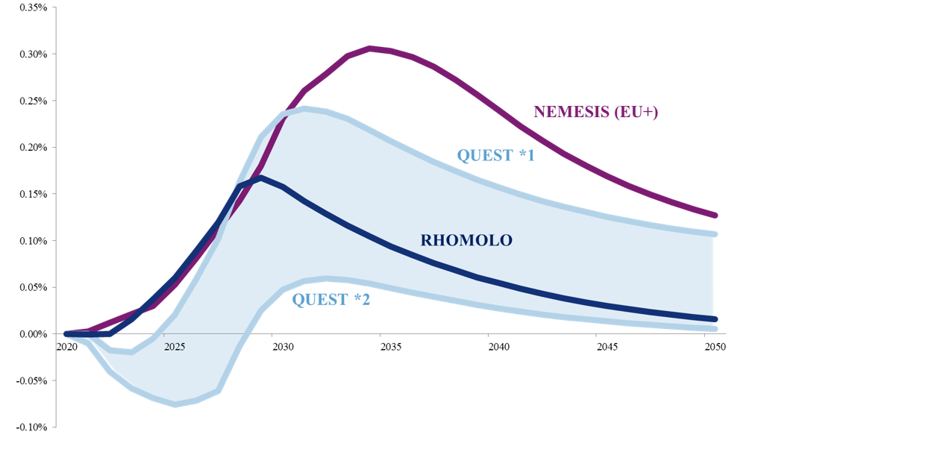
Differences across models
Some differences on short term effects.
No big differences on medium term rates of return (until end of program).
Substantial differences about international externalities (long run effects)
Reasons for differences between models:
NEMESIS vs. QUEST: NEMESIS: public investment has insignificant positive effects + assumes higher net additionality of EU funded projects
QUEST: significant public investment multipliers (see Bom and Lighart, 2014).
RHOMOLO vs. QUEST: RHOMOLO does not have international spillover effects.

Slide 21
Explaining differences across models:
Short run: QUEST has negative short run effects because of labour reallocation between production and R&D. Second, there is a negative labour supply effect because VAT financing in QUEST is reducing labour supply. In the other two models reallocation of labour between sectors is not modelled and there are no negative labour supply effects because public R&D is financed via a reduction of public investment.
Medium run: NEMESIS has the largest medium term effects because of an assumed net additionality of EU funding and because financing via a reduction of public investment is non distortionary, because public infrastructure capital is not productive in NEMESIS.
QUEST has the second largest medium term effect, because it does not assume net additionality and the VAT financing has a dampening effect.
RHOMOLO has the smallest medium term effect because of the absence of net additionality and because of financing via reducing public investment, which has negative supply effects in the medium run.
Long run: NEMESIS and QUEST have more persistent long run GDP effects because of the international spillover channel which is absent in RHOMOLO.

Slide 22
Conclusion
Standard macro assessment models with rates of returns for R&D investment calibrated on empirical estimates of the effects of R&D on TFP arrive at positive GDP effects of public R&D.
What makes public R&D funding unattractive are short run negative effects and positive effects only materialising in the medium term.
But, one also needs to consider:
Opportunity cost of R&D funding: often (nearly) non-distortionary funding is assumed
External effects via technology spillovers are often neglected in national assessments but may be too big in international assessments.
Other considerations:
What are the impacts of different international allocation mechanisms (efficiency vs. cohesion)
What are the distributional effects: income tangible, intangible and labour (by skill)

Slide 24
Reserve Slides

Slide 25
