Slide 1

The value of public research: a time series perspective
Bart Verspagen
verspagen@merit.unu.edu, www.merit.unu.edu
Joint work with Thomas Ziesemer (lead author) and Luc Soete
UNU-MERIT

Slide 2
Motivations for our research
Investment in Science, Technology and Innovation from public funds (“taxpayers’ money”) is large
Hence there is a need to give account of how these investments benefit society
We all have an intuition that “Science is good”, but is this good enough?

Slide 3
Existing R&D policy evaluations
Mostly aimed at firms that “use” public policy (e.g., subsidies, tax incentive schemes)
Mostly based on micro data
Approach based on state-of-the-art econometrics that does not interpret correlation as causation

Slide 4
What about “public science”?
R&D undertaken in universities and public research institutes (Fraunhofer, Max Planck)
Societal impact is broad (economic as well as otherwise), indirect (most value generated by others than the research organization) and hard to quantify
The available econometric work is mostly in the “Griliches tradition”, i.e., production functions that include R&D stocks

Slide 5
Guellec & van Pottelsberghe
Panel data for 16 OECD countries, 1980 – 1998
Error correction model for changes in total factor productivity (macro), with business R&D, foreign R&D and public R&D; public R&D is universities and public research institutes
“The long-term elasticity of [TFP] with respect to business R&D is 0.13 (...) The long-term elasticity of government and university-performed research on productivity is around 0.17” and “public R&D is very valuable to the economy” (the latter based on ror)

Slide 6
Khan & Luintel
Panel data for 16 OECD countries, 1980 – 2002
Dynamic equation that explains TFP from (lagged) knowledge stocks and other variables (no EC)
Interact all stocks and other production variables with a range of other variables (FDI, high-tech exports, education, etc.) to account for heterogeneity in R&D returns over countries

Slide 7
Khan & Luintel – results
Results of the first equation are “[in] disagreement with the existing empirical literature that reports positive and statistically significant effects of the sources of knowledge on domestic productivity”
But accounting for heterogeneity, “[the stocks of business, foreign and public R&D] exert positive and statistically significant effects of varying magnitudes on (…) productivity”

Slide 8
Van Elk et al. (incl. Verspagen...)
Re-run these models using different production functions (CD, Translog) and specifications (incl. EC and Khan & Luintel)
Find no robust evidence of a significant impact of public R&D on TFP, except with the Khan & Luintel model that stresses heterogeneity

Slide 9
A different approach
If there is heterogeneity, it makes sense to estimate at the country level, which ultimately makes it a time series approach
We apply a vector-error-correction (VEC) model to the same data as in the “Griliches” approach
We go back to the early 1960s in terms of data, using OECD archives for the R&D data

Slide 10
The VEC approach – basics
It specifies a number (>1) of long-run relations between the endogenous variables of the model (co-integration relationships): multi-dimensional version of Guellec & van Pottelsberghe
The residuals in this relationship represent a deviation from long-run equilbrium (“error terms”)
The error terms are included in a vector autoregression model (VAR) that takes first differences of the endogenous variables as the dependent variables

Slide 11
The VEC approach – dynamics & estimation
In a stable system, a transitory or permanent shock to one of the variables will lead to adjustment dynamics through the VAR part, into the long-run relations
We can simulate this process based on the estimated parameters of the system
Estimation involves deciding
  How many long-run relations are to be included
  How many lags in the VAR part
  Which (insignificant) variables to exclude
All such decisions have been made on the basis of elaborate testing (on which I will not elaborate)

Slide 12
First VEC model – Netherlands, public & private
R&D stocks, public R&D = GERD – BERD (who carries out the R&D?)
4 long-run equations
  TFP depends on domestic private and public R&D stocks (both +)
  Domestic private R&D stock depends on foreign private (-) and public R&D (+)
  Domestic public R&D stock depends on foreign public R&D and domestic GDP (both +)
  Foreign private R&D stock depends on foreign public R&D stock and domestic TFP (both +)
We analyze transitory and permanent shocks, with rates of return to the latter

Slide 13
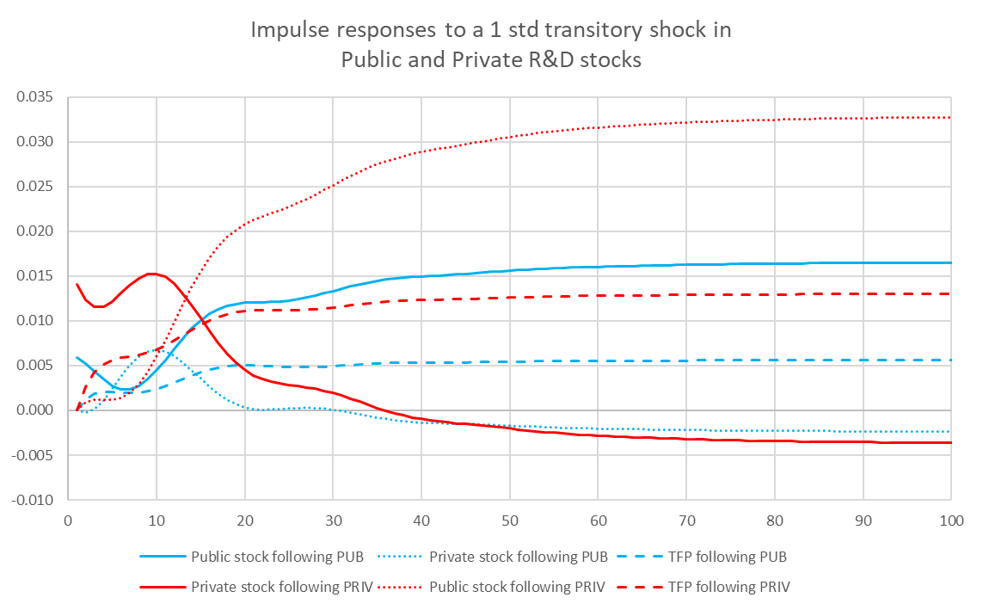
Transitory shock to domestic R&D stocks

Slide 14
A permanent shock to public R&D stock
We add 0.005 to the intercept of the long-run equation for public R&D stock (intercept is estimated at 0.027) in 1970
Then we simulate the model (stochastically) until 2040
We can calculate a rate of return

Slide 15
Permanent public R&D shock – results

Slide 16
The rate of return to public R&D
Benefits are yearly increases of GDP
Costs are gross investments in R&D
We use a discount rate of 4% per year
We do not consider production costs for GDP
This yields a rate of return of 131.5% for the permanent shock scenario (2040)

Slide 17
Can we estimate the model for mission-oriented public R&D?
We use GBAORD (publicly funded!) data broken down by NABS category to define mission-oriented R&D
  Environment, Space, Energy, Health, Military
We collect archived GBAORD data going back to 1970 (only available for early EU countries)
Preliminary estimation results for NLD (not much military, compared to e.g., France and UK)

Slide 18
Shocks to mission and non-mission oriented public R&D
Rates of return: 167% (Mission) and 242% (non-Mission)

Slide 19
Conclusions - I
Existing approaches to estimating rate of return to public R&D are based on cross-section or panel data
They robustly show positive and significant rates of return, but only when accounting for country heterogeneity (systems of innovation?)
This suggests a time series approach for individual countries and based on long time series

Slide 20
Conclusions – II
We implemented this approach for the Netherlands, and are working on more countries
Our results show robust and positive rates of return to public R&D (131.5% for NLD)
We are extending our approach to mission-oriented public R&D, preliminary NLD results show higher rate of return to non-mission oriented R&D
I am curious how these rates of return (or results more generally) compare to what is used in the DSGEs of FRAME

